Slide 1
An efficient parameterized algorithm for m-set packing
Weijia Jia, Chuanlin Zhang, and Jianer Chen
Journal of Algorithms 50 (2004) 106-117
Presenter: Yung-Hsing Peng
Date: 2005.08.05

Slide 2
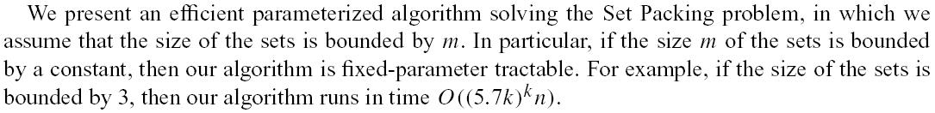
Abstract

Slide 3
Set Packing Problem
Input Description: A set of subsets C = S1, ..., Sn
Problem: What is the largest number of mutually disjoint subsets from C?
This problem is NP-complete, even if we change the model to m-set packing (every set contains m elements).
The authors propose a parameter-tractable algorithm on m-set packing problem. (note that the time complexity for brute force is O(n^{k}))

Slide 4
Example for m-set packing
Given a set of sets with m=4, n=8, k=4
(1, 2, 5, 6)
(1, 2, 3, 4)
(5, 6, 7, 8)
(7, 8, 11, 12)
(9, 10, 11, 12)
(9, 10, 13, 14)
(11, 12, 15, 16)
(13, 14, 15, 16)
→ The answer is “yes”, and the 4-set packing of 4 sets is (1, 2, 3, 4) (5, 6, 7, 8) (9, 10 ,11, 12) (13, 14, 15, 16)

Slide 5
Main Idea
There exists a nondeterministic algorithm to solve m-set packing problem.
The authors de-nondetermine the nondeterministic algorithm and obtain a deterministic algorithm. From analysis of the time complexity, the authors prove their algorithm parameter tractable.

Slide 6
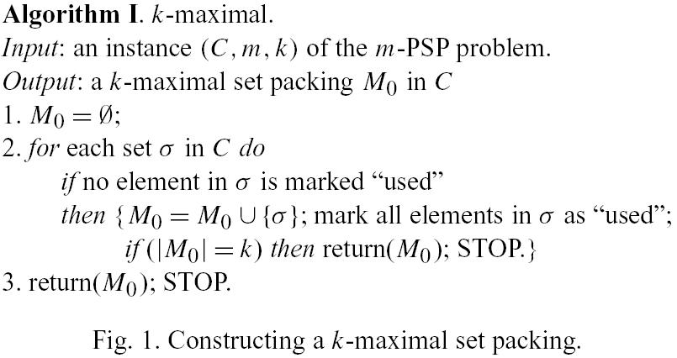
Algorithm I
Using the example in previous page, we have (1, 2, 5, 6) (7, 8, 11, 12) (9, 10, 13, 14)

Slide 7
Information in Algorithm I
If |M₀| = k, then we’ve done the job.
If |M₀| < k/m, then there doesn’t exist a set packing of size k.
We need only consider the cases where k/m ≤ |M₀| < k

Slide 8
Partial Set and Regular Set
Regular Set: no ‘*’ symbol
Partial Set: with ‘*’ symbol
For example, A = (1, 2, 3, 4) is a regular set, while B = (1, 2, *, *) is a partial set. Here we have reg(B) = (1, 2).

Slide 9
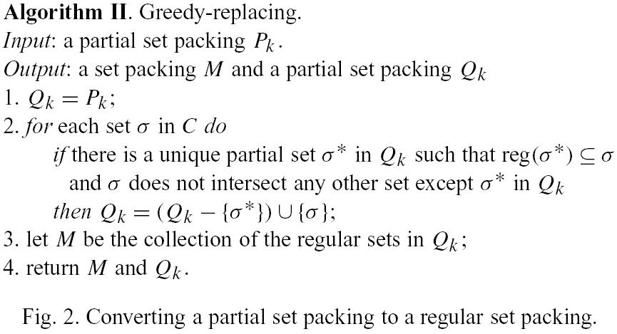
Algorithm II
There may be some partial sets left in Q_{k} when this algorithm finishes.
Combine algorithm I and II, we can obtain a nondeterministic algorithm in next page.

Slide 10
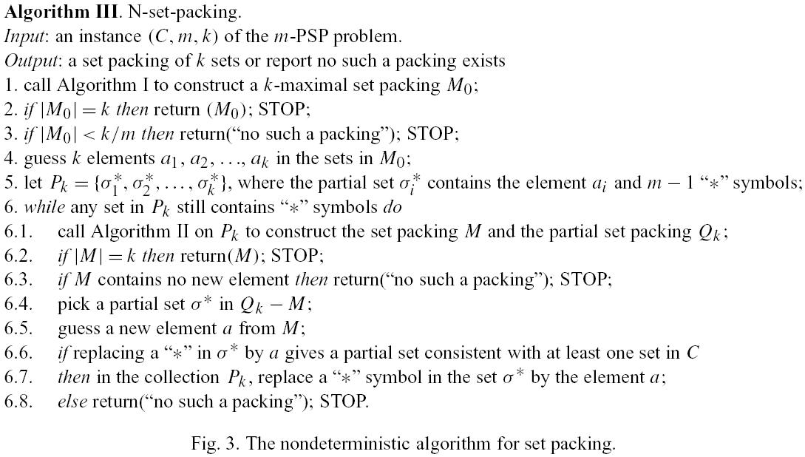
Algorithm III
If we can devise a deterministic algorithm for the “guessing part” (red circle), then we can obtain a deterministic algorithm (spanning set + maximum matching).

Slide 11
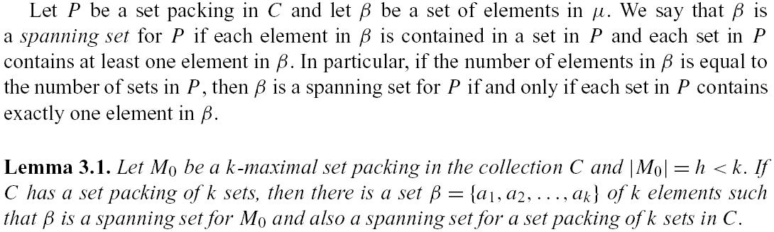
Spanning Set
We can use β as an efficient way to enumerate all possible k elements in step 4. The authors proved that the number of β is much smaller than n^{k} (exhaustive enumeration).

Slide 12
Maximum Matching in Bipartite Graph
If there are exactly one ‘*’ in every set in the given partial set, then we can change the replacing problem in the “while loop” to a well known problem called “maximum matching in bipartite graph”
In this case, we can solve the replacing problem in O(h³)[10], where h denotes the number of partial sets.
Please read the paper for detailed description.

Slide 13
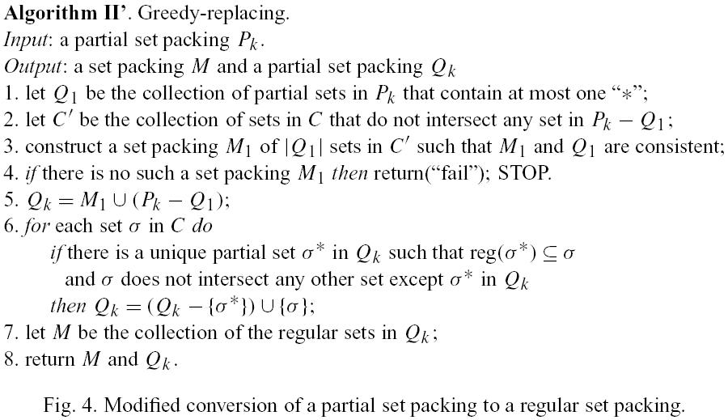
Algorithm II’

Slide 14
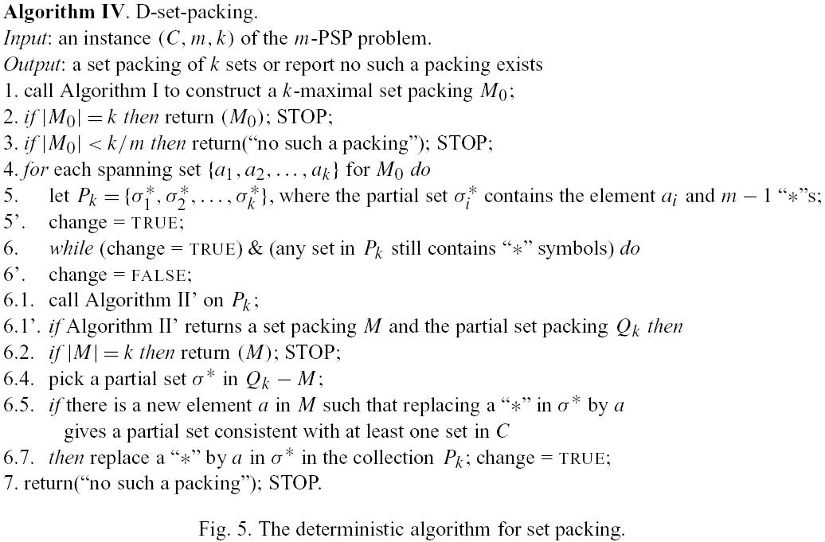
Algorithm IV
The time complexity of algorithm IV is O(g(k, m)n) (Please read the paper)

Slide 15
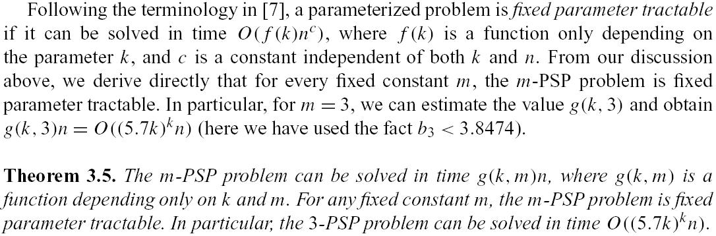
Conclusion
The authors enumerate the mk elements in k sets efficiently.

Slide 16
Reference

